Slide 1
Software Design and Architecture
Object Relational Mapping: A Persistence Mechanism for OO Applications

Slide 2
Data Management Systems
Until recently, the most efficient way to store data was in a relational database
A relational database can store vast amounts of data in a structured way that allows for efficient storage, access, and search
More recently, so called NoSQL solutions have been gaining production use on truly vast datasets with realtime and concurrent operational constraints
Think Facebook and Twitter and their use of Hadoop and Cassandra

Slide 3
Object-Relational Paradigm Mismatch
In the Object Systems, the problem with these persistence
mechanisms is that their core abstractions are not objects
They are tables with rows and columns (RDBMS)
Or
They are (some variation on) key-value pairs (NoSQL)

Slide 4
Object-Relational Paradigm Mismatch
The OO application, on the other hand, has
Classes, sub-classes, inheritance, associations
Objects, attributes, methods, polymorphism
These concepts do not easily map into the abstractions of persistence mechanisms
Even the creation of serialization mechanisms is non-trivial with the work that has to go in to traversing and reconstituting an object graph

Slide 5
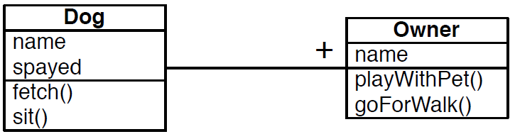
An Example
In this object system, you will have Dog objects and Owner objects and some of them will be related to each other
You would represent this UML diagram in the relational database as follows
a table called dogs to store Dog instances and
a table called owners to store Owner instances
columns corresponding to each attribute (plus an implicit id column)
row corresponding to an instance of the class

Slide 6
How do we handle the relationship between Dog and Owner in this object-relational mapping system?
Based on the diagram
Each owner has a single dog
Each dog has at least one owner
This means that two owners can own the same dog
Owner participates in a “has_one” relationship with Dog
Dog participates in a “has_many” relationship with Owner

Slide 7
How do we handle the relationship between Dog and Owner in this object-relational mapping system?
The short answer is
foreign key relationships and join tables
The somewhat longer answer is that most object-relational mapping systems have ways to specify these relationships
They then take care of the details automatically
You might see code like:
List<Owner> owners = dog.getOwners();
Behind the scenes, the method will hide the database calls required to find which owners are associated with the given dog

Slide 8
How do we handle the relationship between Dog and Owner in this object-relational mapping system?
Each instance of dog is assigned a unique id
1 | Fido | true
2 | Spot | false
Likewise owners
1 | Ken
2 | Max
A third table is then used to maintain mappings between them
1 | 1 ; 1 | 2 ; 2 | 2
This says that Fido is owned by Ken and Max and Spot is owned by Max

Slide 9
How do we handle the relationship between Dog and Owner in this object-relational mapping system?
That third table is known as a join table and has the structure
dog_fk | owner_fk
“1 | 1” in a row says that dog 1 is owned by owner 1
When it is time to implement the code
List<Owner> owners = dog.getOwners();
Then
the code gets the id of the current dog asks for all rows in the join table where dog_fk == “id of current dog”
this provides it with some number of rows; each row provides a corresponding owner_id which is used to lookup the names of the associated owners

Slide 10
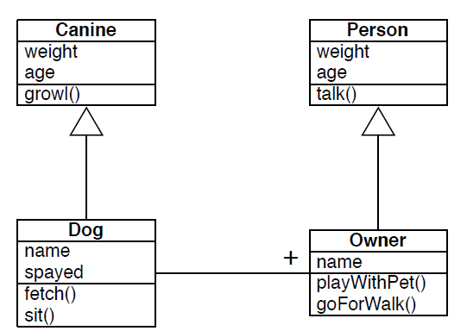
A complication

Slide 11
How is inheritance handled?
The answer is “it varies across object-relational mapping systems”
Hibernate, has options to embed the attributes of the superclass into the tables of the subclasses
Rather than one table per class, no table is generated for the superclass; instead one table per (leaf) subclass is generated
the subclass table then has columns for each of the superclass atts

Slide 12
How is inheritance handled?
The answer is “it varies across object-relational mapping systems”
ActiveRecord (for Ruby on Rails) has options for
creating a single table for the superclass and for each object storing all attributes as key-value pairs in a map
subclasses are stored in the superclass table and have the option of adding key-value pairs to the map that only they process

Slide 13
How is inheritance handled?
The answer is “it varies across object-relational mapping systems”
There are other options
including having distinct tables for each superclass and subclass and using foreign-key relationships to track relationships between tables
an instance of a subclass would get its values from multiple tables

Slide 14
How is inheritance handled?
The important point is that the object-relational mapping system will hide the details from you
You’ll create a new instance and then invoke “save()” and the object gets picked apart and its values get stored in the appropriate tables

Slide 15
ORM Systems?
There are many different ORM systems available
CoreData from Apple
Hibernate from JBoss
ActiveRecord from Ruby on Rails

Slide 16
Hibernate
The most popular JPA vendor is Hibernate (JBoss)
JPA 1.0 was heavily influenced by Gavin King, the
creator of Hibernate
Much of what exists in JPA is adopted directly from
the Hibernate project
Many key concepts such as mapping syntax and
central session/entity management exist in both

Slide 17
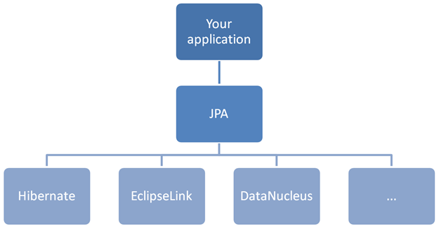
JPA is just an API (hence Java Persistence API) that requires an implementation to use.
Popular implementations include Hibernate, EclipseLink, OpenJPA and others.

Slide 18
Key Concepts
JPA utilizes annotated Plain Old Java Objects (POJOs)
Define an EntityBean for persistence
@Entity
Define relationships between beans
@OneToOne
@OneToMany
@ManyToOne
@ManyToMany

Slide 19
Key Concepts Cont...
Primitive types and wrappers are mapped by default
String, Long, Integers, Double, etc.
Mappings can be defined on instance vars or on accessor methods of the POJO
Supports inheritance and embedding
EntityManger is used to manage the state and life cycle
of all entities within a give persistence context
Primary keys are generated and accessed via @Id
annotation

Slide 20
An Example
Design an application that allows a customer to view all
employees that physically reside in a specific office
Each employee may only reside in one office
Employees must have first name, last name, phone number, id
Each office must have name, postal address, id

Slide 21
The Model

Slide 22
From Model to Code
Our model contains four classes
Office
Employee
DomainObject
PostalAddress
Office and Employee inherit from DomainObject
DomainObject holds on to best practice attributes such
as id, creation date, modified date, version, etc.

Slide 23
From Model to Code Cont...
@Entity must be used to tell JPA which classes are eligible for persistence
@ManyToOne must be used to tell JPA there is an aggregation between Office and Employee
We’ll show a use of @Embedded and @Embeddable
for the Office-PostalAddress relationship
As well as inheritance using @MappedSuperclass

Slide 24
Domain Object

Slide 26
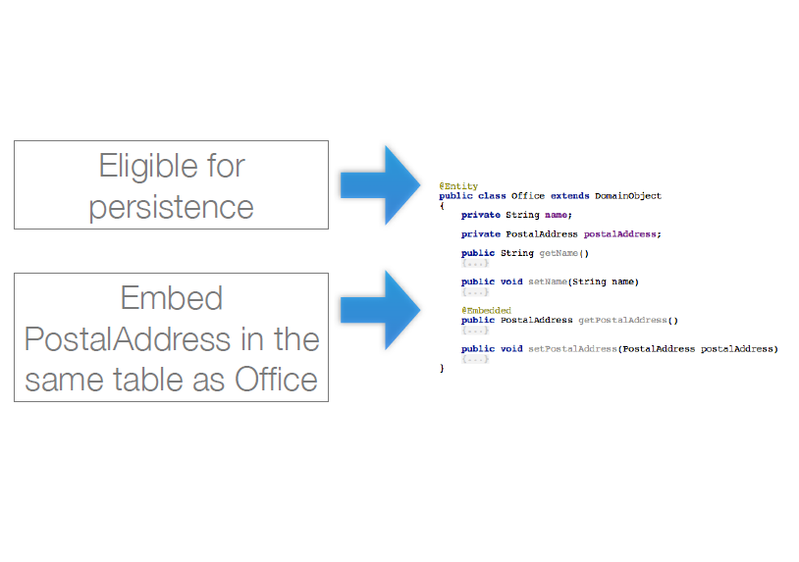

Slide 27
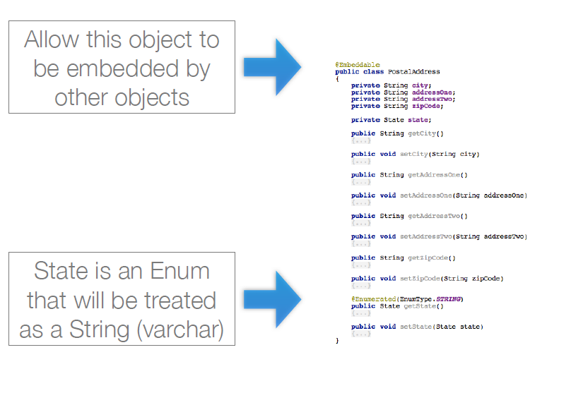

Slide 29
Explanation
@Embeddable and @Embedded
Allows for the attributes of an embedded class to be stored in the same table as the embedding class
@Enumerated
Allows for the value of an Enum to be stored in a column in the class’s database table
@MappedSuperclass
Allows for all attributes of the superclass to be utilized by the subclasses
Duplicates all superclass attributes on subclass tables

Slide 30
The Database
JPA is capable of generating the underlying database
for the developer
Most aspects of the generation are available for
customization
The defaults are generally good enough
Any @Entity causes the generation of a database
table. Our generated tables are:
Office table
Employee table

Slide 31
Office Table
Field Type
id bigint(20)
createDate datetime
modifiedDate datetime
version int(11)
name varchar(255)
addressOne varchar(255)
addressTwo varchar(255)
city varchar(255)
state varchar(255)
zipCode varchar(255)

Slide 32
Employee Table
Field Type
id bigint(20)
createDate datetime
modifiedDate datetime
version int(11)
firstName varchar(255)
lastName varchar(255)
location varchar(255)
phoneNumber varchar(255)
office_id bigint(20)

Slide 33
JPA is a specification that a developer can code to in order to easily leverage ORM technologies
There are a wide variety of vendors that implement the specification
Coding to the spec allows the developer to be flexible in their choice of vendor implementations with limited ripple throughout the codebase
JPA greatly simplifies persistence of POJOs through a small set of easily utilized annotations

Slide 34
A Player-Team Example with Hibernate
Entities represent a player and a team with a one-to-many relationship. Each team could have many players, whereas a player could only play with a single team at a time.
@Entity
public class Player {
@Id
@GeneratedValue(strategy=GenerationType.SEQUENCE, generator = "player_Sequence")
@SequenceGenerator(name = "player_Sequence", sequenceName = "PLAYER_SEQ")
private Long id;
@Column(name = "name")
private String name;
@Column(name = "num")
private int num;
@Column(name = "position")
private String position;
@ManyToOne(fetch = FetchType.LAZY)
@JoinColumn(name = "team_id", nullable = false)
private Team team;
public Player() {
}
// getters/setters
}
@Entity
public class Team {
@Id
@GeneratedValue(strategy=GenerationType.SEQUENCE, generator = "team_Sequence")
@SequenceGenerator(name = "team_Sequence", sequenceName = "TEAM_SEQ")
private Long id;
@Column(name = "name")
private String name;
@OneToMany(cascade = CascadeType.ALL,
fetch = FetchType.EAGER,
mappedBy = "team")
private List<Player> players;
public Team() {
}
// getters/setters
}

